Slide 1
Housing price prediction

Slide 2
DONE BY:
A.DEEPAK BALAJI –19BCE1816
P SUBIKSHA- 19BCE1255

Slide 3
TABLE OF CONTENTS
1. Introduction
2. Procedure
3. SECTION 1
3.1 front end
3.2 website
4.SECTION 2
4.1 Dataset Used
4.2 Independent and Dependent variables
4.3 Concepts used to build the Model
5.References

Slide 4
INTRODUCTION
The purpose is to create a convenient and easy-to-use application for the customer, trying to know the price of a house in a particular location. They can make use of the online website which we have created and moreover it is beneficial for both customer and for the real estate people.This website is very helpful especially for migrated people.

Slide 5
PROCEDURE
Firstly, taking the datasets of home price from kagle.com and using that we design a machine learning model by covering some of data science concepts like Datacleaning, Feature Engineering, Outlier Detection, Dimensionality Reduction. Once the model is built we move it to a picklefile. And then will write a python flash server which can consume this picklefile and then it will predict the price for the customer. This python flash server will expose HTTP endpoints for various requests and the UI written in html,CSS and Javascript will make HTTP get and post calls. In terms of tools
and technology, python has been used. Pandas for datacleaning. HTML,CSS,Javascript for the website

Slide 6
Section 1

Slide 7
FRONT END
In front-end,a catchy website has been created using html,css for styling,javascript so that it will be very useful for the user to interact with the system.
Javascript contains the dynamic code which will make HTTP calls to our back-end retrieve the data so this is more of server communicator ie it communicates with server gets the data and runs the dynamic code.
We made it sure that the style which we have used here in the webpage would pertain with the modern world.
This website is user-friendly, like if the customer wish to give any feedback, they are welcomed. And if the customer wants to know some information they can approach the visited customer, as the visited customer’s details are linked in the website.

Slide 8
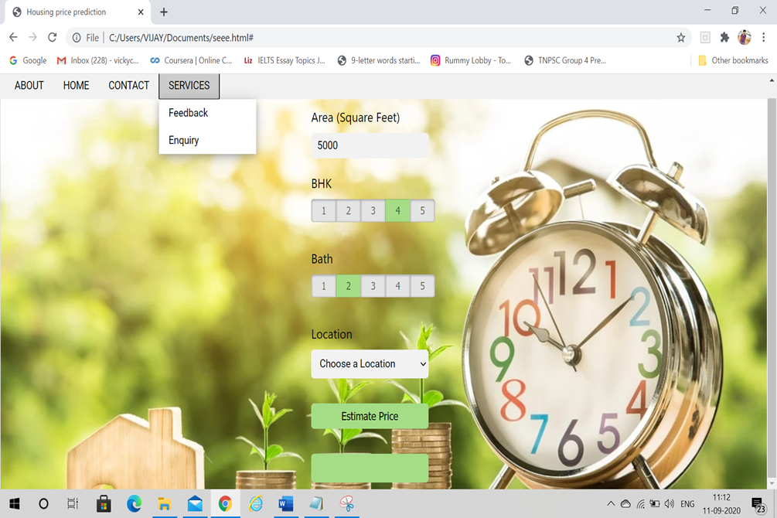
HERE IS OUR WEBSITE

Slide 9
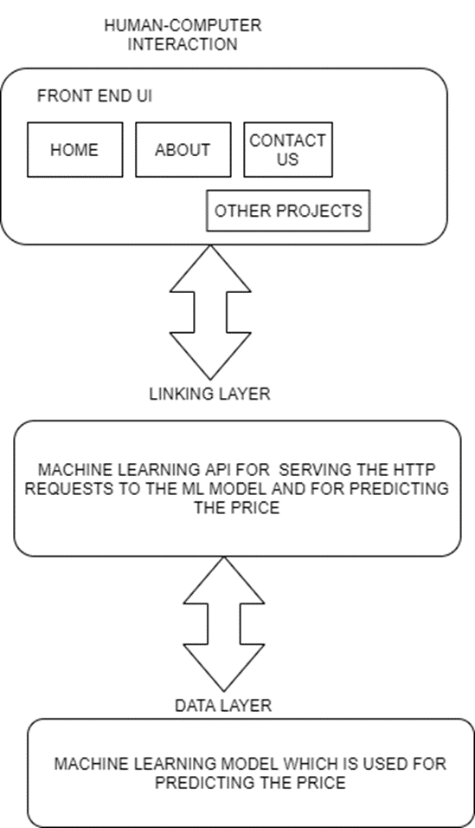
LAYERED ARCHITECTURAL DESIGN

Slide 10
SECTION-2
MACHINE LEARNING MODEL

Slide 11
DATASET USED
To build our machine learning model we have
used a dataset from kaggle.com.
Since we all know about the housing prices in chennai so we decided to pick a dataset which does not pertain to chennai.
So in this fashion we have took and analyzed
the dataset of bangalore house price data.
This Dataset consists of attributes such as:
area_type,availability,location,size,society,total_sqft,bath,balcony,price

Slide 12
INDEPENDENT AND DEPENDENT VARIABLES
The main objective in this project is to predict
the price
So the independent variables are:
Area_type,availability,location,size,society,
total_sqft,bath and balcony
Since we are predicting the price the dependent
Variable is price.

Slide 13
CONCEPTS USED TO BUILD THE MODEL
Data Cleaning
Feature Engineering
Outliers Removal
Dimensionally Reduction
K fold cross validation and Grid SearchCV

Slide 14
DATA CLEANINIG PROCESS
In this process we refined our dataset by changing the values of certain columns such as
in size column the size of the house was not uniform like some where 2bhk , 4 bedroom and 1RK. So to remove these non-uniform data we used lambda function to split the integer part and the string part in the above example and we saved the integer part alone in a new column called bhk in a new data frame such that the size column might look uniform.

Slide 15
While traversing through the sqft column we found that in our dataset some data where in a range like 1133-1384.
So to resolve this we took an average of these
kinds of data which were in a range and we saved it back to our dataframe
We also removed some data in our data frame which were null.

Slide 16
FEATURE ENGINEERING AND DIMENSIONALITY REDUCTION
We know that in the Real Estate market
Price_per_sqft is a very important aspect so for that we have created a new column price_per_sqft
in our Data frame so that it would be helpful for us in Model building.

Slide 17
When we analyse the dataset we found there were around 1304 locations which was a huge value so to solve this issue we did some dimensionality reduction techniques here.
while traversing through the data frame
we found that there were many locations which
had only one or two data points which was a wasteful resource for our model
So to resolve this issue we categorised those locations as ‘other’ such that it would be helpful for refining our dataset and for a good model building

Slide 18
OUTLIER DETECTION AND REMOVAL
Outliers are data points which be called as data errors or can also be called as extreme variations of the data points in our dataset
When we examined our data set we found some data points where we got for a 1020 sqft home there were 6 bhk so it was not much valid data point and we got another data point where for a 600 sqft home we got around 8 bhk
So we removed those outliers for our data frame for a good model building

Slide 19
When we plotted a scatter plot between Total square feet area and price we found out some outliers that the price of a 2 bhk house is greater than the price of a 3bhk house which had the same sqft area and were belonging to the same location
So we tried to remove these outliers as well

Slide 20
Then we examined homes which had more
than 10 bathrooms and we got some data which was incorrect such as homes with 5245.0 sqft and
13 bath
So we negated those Outliers from our dataset

Slide 21
K FOLD CROSS VALIDATION AND GRID SEARCHCV
We built a linear regression model and we were checking the efficiency for the model to predict the price given location, bath , total_sqft
and bhk.
After Training our model for some time we got
a best score of 0.818354 which was a good score
So now our model is ready….

Slide 22
REFERENCES
Kaggle.com
W3 schools
Tutorials point

